Slide 1

Predicting Prices for Airbnb Accommodations
Capstone Project
Notes:
Good Morning everyone,
welcome to my capstone Project!
=]

Slide 2







Problem Statement
About: Renting accommodation’s site
Audience: primary and secondary
Metrics: Regression Problem - RMSE
Notes:
My capstone project it's related to the Airbnb Data - the renting accommodations site.
I went throught this data for the NYC listings and I propose as the problem statement for this project , develop a machine learning model that can predict prices for new accommodations there to be listed on the Airbnb website.
Here I'm considering two types of audience:
the main audience as being Airbnb boarding, interested in provide to the user a price suggestion during the listing process based on its main features such as type of accommodation, number of rooms and neighborhood.
the secondary stakeholders would be people who are interested in using the Airbnb service by making their properties available for rent on their website and having an idea of how much this service could earn from it.

Slide 3
About Data
Datasets:
Listing accommodations New York City;
38,000 x 75
Neighborhoods price;
~180 neighborhoods
Cleaning Process:
Null values, Input Strategies, Regex, Feature Engineering, handle outliers;
25,000 x 23
Notes:
Two data sets were used in this project. The first 'Listings.csv' with 39,881 rows and 75 columns was acquired through the Airbnb data explorer website [1] and contains information related to all accommodations listed on the website for the quarterly data for the last 12 months (Oct 2021 - Sept 2022).
Another dataset was also used to add value to the modeling of our model - Neighborhood_price.csv - and was acquired in the data dashboard of the Street Easy website, which contains information regarding the real estate market in New York City and contains square foot prices for rentals in major its neighborhoods.
After cleaning the data, applying features engineering and input strategies we got a final dataset of size 23645 x 23 to training our machine learning models.
and then we remove the outliers

Slide 4
Data Science Workflow
Cleaning Data
Null values, Input Strategies, Feature Engineering
EDA
Continuous, Discrete and Categorical Variables Plots
Model
Supervised and Unsupervised Learning
Notes:
Two data sets were used in this project. The first 'Listings.csv' with 39,881 rows and 75 columns was acquired through the Airbnb data explorer website [1] and contains information related to all accommodations listed on the website for the quarterly data for the last 12 months (Oct 2021 - Sept 2022).
Another dataset was also used to add value to the modeling of our model - Neighborhood_price.csv - and was acquired in the data dashboard of the Street Easy website, which contains information regarding the real estate market in New York City and contains square foot prices for rentals in major its neighborhoods.
After cleaning the data, applying features engineering and input strategies we got a final dataset of size 23645 x 23 to training our machine learning models.
and then we remove the outliers

Slide 5
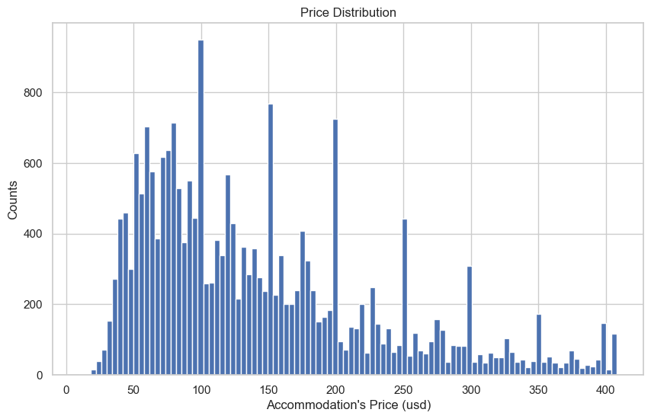
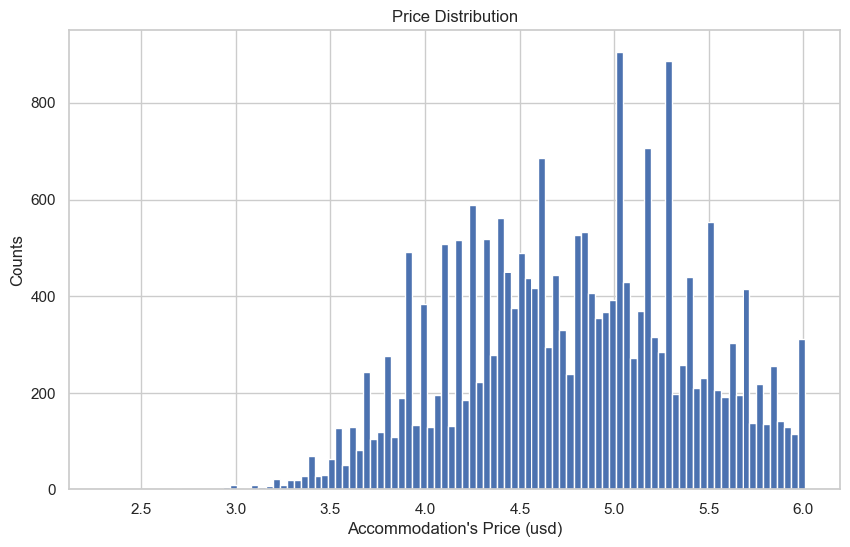
Exploratory Data Analysis
Distributions:
skewness /log transformation
Notes:
I started the analysis by looking at how the distribution of price listings behaves in the histogram chart and we could observe that the data is skewed to the right.
When this happens, it is common to apply a logarithmic transformation to the target (price) in an attempt to correct it. In our specific case, we applied this transformation and achieved a slight increase in test and training scores in most of our models.

Slide 6
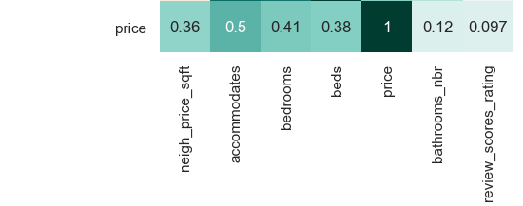
Exploratory Data Analysis
Correlations with the target;
latitude/longitude x neighborhood;
Notes:
those were the continuous variables more correlated to the target: capcity_accomodate, bedroms, beds, neigborhhod sft price, and nuber of bathroms;
but these were the main features that I consider at the modeling

Slide 7
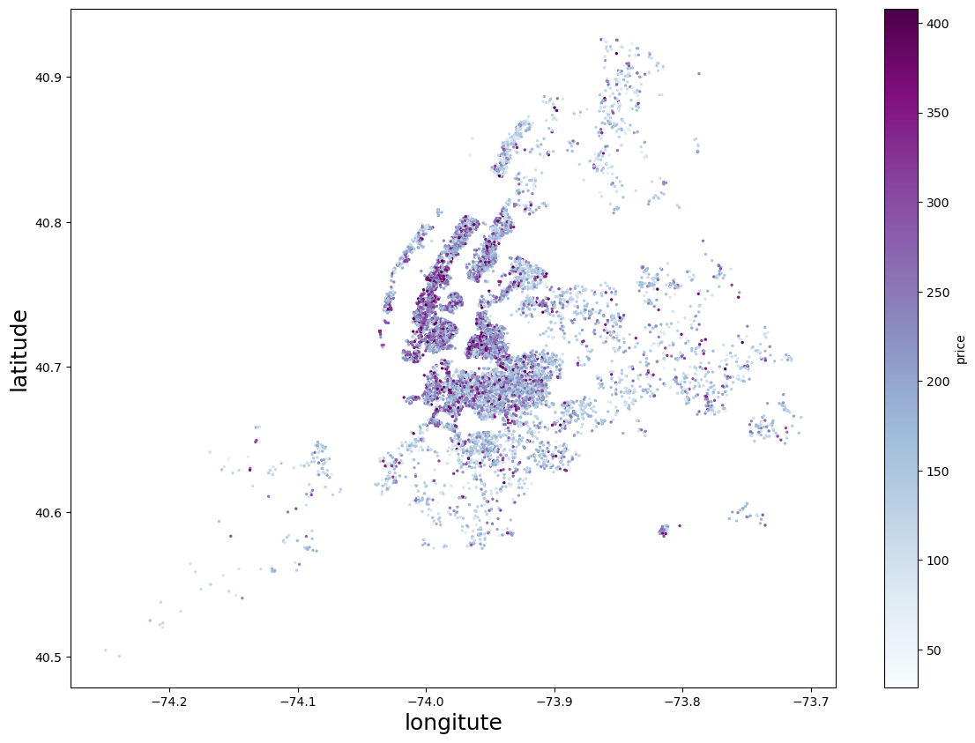
Exploratory Data Analysis
latitude/longitude variables;
Notes:
Longitude and latitude also have a relatively strong relationship with price, however we can understand that this information is already 'included' in the category variable neighborhood.
The boxplot below shows the 10 highest priced neighborhoods in NYC and the neighborhood group they're belong to.

Slide 8
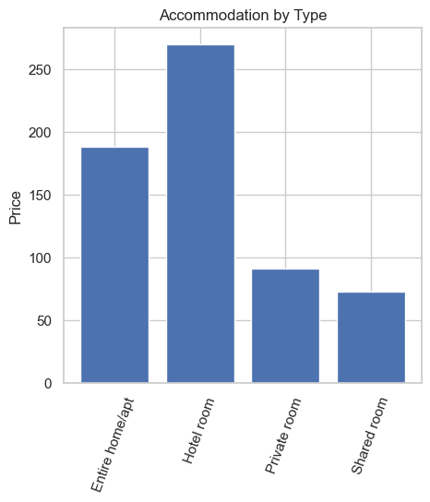
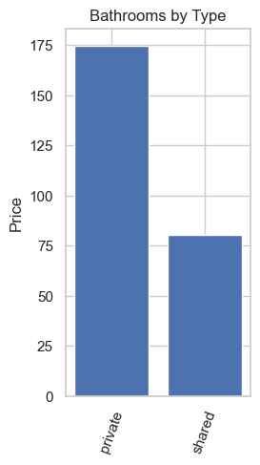
Exploratory Data Analysis
Boxplot for categorical variables
Notes:
So i looked at the categorical variables like type accommodation showing Hotel room as the most expesie amog them follow bu Entire apto
and the bathroom. type as privete one with higher price

Slide 9
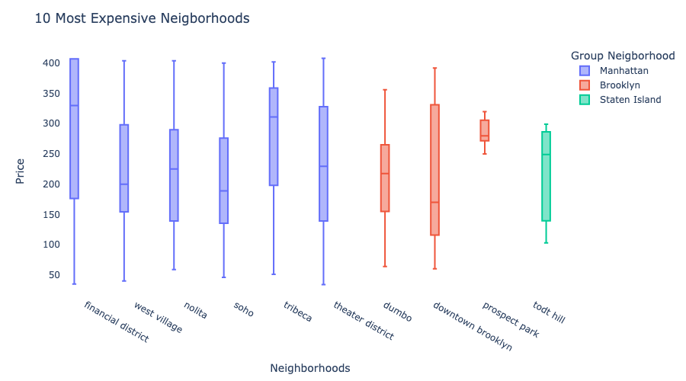
Exploratory Data Analysis
Notes:
The boxplot below shows the 10 highest priced neighborhoods in NYC and the neighborhood group they're belong to.
Six of them belongs to manhathan;

Slide 10
Models Evaluation
Tranformers:
One Hot Encoded;
Scalling;
Models:
Supervised: Linear Regression / KNN
Unsupervised: Decision Trees / RainForest / Neural Networks
Techniques:
Regularization
Gridsearch
Notes:
The dataset with 23 columns in total was scaled and hot encoded before being used to training our models. We started our model evaluation checking the baseline model and getting its score which has a negative value of -0.0001 meaning that the model is pretty bad at predictions.
At first, we implemented a linear regression model and got a score of 0.64932 on the training set and -4.4354 on the test set. A Linear Regression model can be a good choice in a regression problem because its coefficintes can be used to interpret or to do inference at the target variable if the LINE assumptions be met. In this particular case, the LINE assumptions were not met so we couldn't use its coefficients to inference. Following, we applied lasso and ridge reguralization to see if it can improve its performance and we got the scored for Lasso 0.6361(Train), 0.6272 (Test) and 144.961 (RMSE). The scores for Ridge were 0.6401 (Train), 0.6295 (Test) and 144.774 (RMSE).
Then the following models were implemented: K-Nearest Neighbors Regression, Decision Tree Regressor, RainForest Regressor, Recurrent Neural Network associated with gridsearch and stacking techniques.
Below is the benchmark table with the three models that had the best score among them.

Slide 11
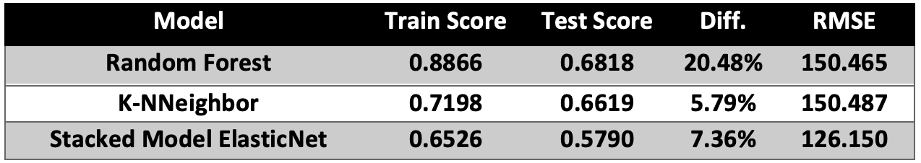
Models Evaluation
Benchmark’s Model:
Notes:
The Rain Forest model had the scores 0.8866 (Train), 0.6818 (Test) and 150.465(RMSE) and we chose this one as the best model because it had the higher score on the Test set and not that bad value at RSME. This model was also the one selected to be used in the Streamlit app to predict the prices simulation. The code for the app can be found at the app folder in this same repository.
Later, in a second attempt to buid better models, we try to apply transfer learning using clusters. so we create a new column 'cluster' using KMeans() to replace the column 'neighborhoods' and see if the performance models increase. For this, a search for best value of k was performed and returned the k value equals 150 - according to the silhouette value.

Slide 12
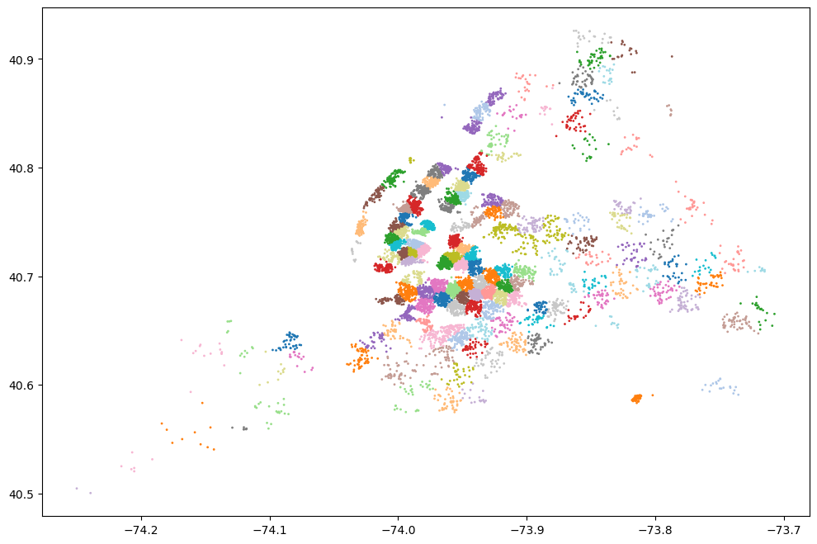
Transfer Learning
Transfer Learning using KMeans
k = 150, using silhouette score;
Notes:
Later, in a second attempt to build better models, we try to apply transfer learning using clusters. so we create a new column 'cluster' using KMeans() to replace the column 'neighborhoods' and see if the performance models increase. For this, a search for best value of k was performed and returned the k value equals 150 - according to the silhouette value.

Slide 13
Conclusions and Recommendations
Conclusions:
feature engineering 'amenities_count' and 'description_listing_count’ ;
latitude/longitude or cluster with transfer learning to replace the neighborhood;
some variables are more important than others in determining the accommodation' prices
(the neighborhood feature carries more weight to the target than the number of beds or baths)
Notes:
We could get at two conclusions for this project:
first one, the feature engineering 'amenities_count' and 'description_listing_count' didn't increased the performance on our models and,
the second one, play around latitude/longitude or cluster with transfer learning to replace the neighborhood didn't also work.
Another conclusion after analyzing the data, it's that some variables are more important than others in determining the accommodation' prices, for example, the neighborhood feature carries more weight to the target than the number of beds or baths.
As a suggestion, after these conclusions, it is consider that if you want to add value to accomodation it will be more efficient increase the capacity of accommodate people than necessarily adding a room for it.

Slide 14
Conclusions and Recommendations
Recommendations:
Between 5 groups of neighborhood Manthan has so far the higher If you living in Manhathan
more efficient increase the capacity of accommodate people than necessarily adding a room;
Notes:
We could get at two conclusions for this project:
first one, the feature engineering 'amenities_count' and 'description_listing_count' didn't increased the performance on our models and,
the second one, play around latitude/longitude or cluster with transfer learning to replace the neighborhood didn't also work.
Another conclusion after analyzing the data, it's that some variables are more important than others in determining the accommodation' prices, for example, the neighborhood feature carries more weight to the target than the number of beds or baths.
As a suggestion, after these conclusions, it is consider that if you want to add value to accomodation it will be more efficient increase the capacity of accommodate people than necessarily adding a room for it.

Slide 15
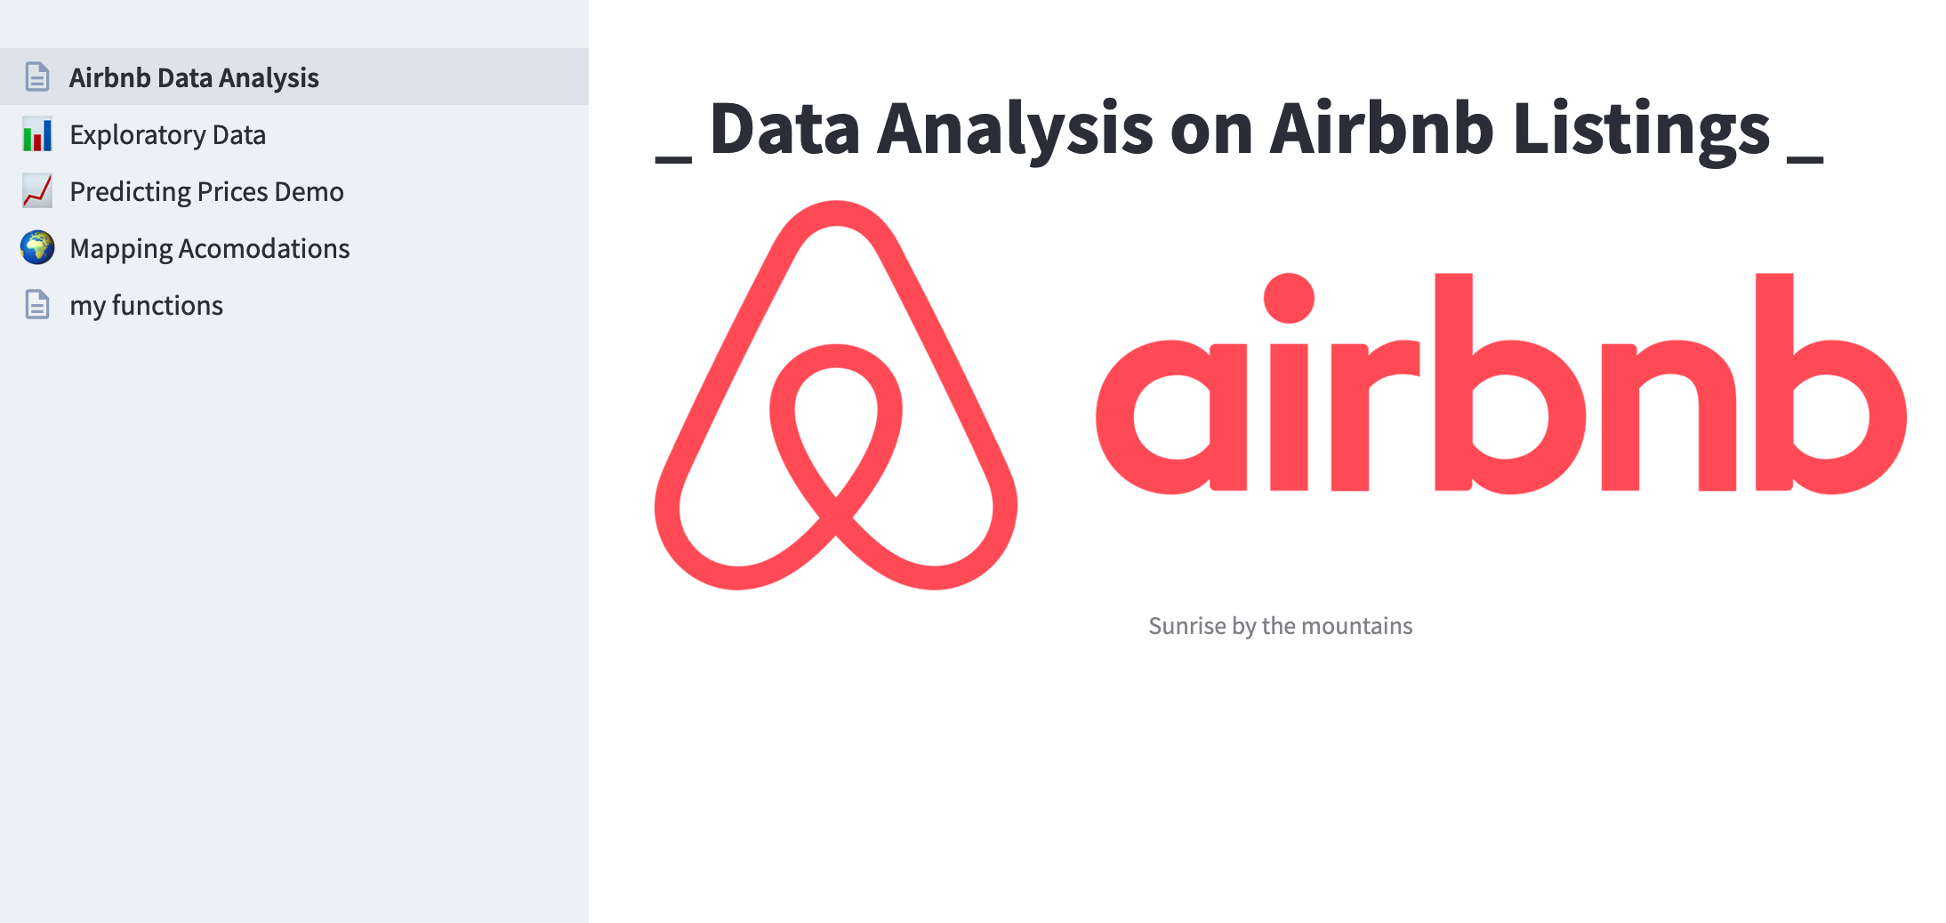
Airbnb App
App to explorer Airbnb Listing Data and Predicting Prices:
Airbnb Explorer App

Slide 16
Thank You!

